Slide 1
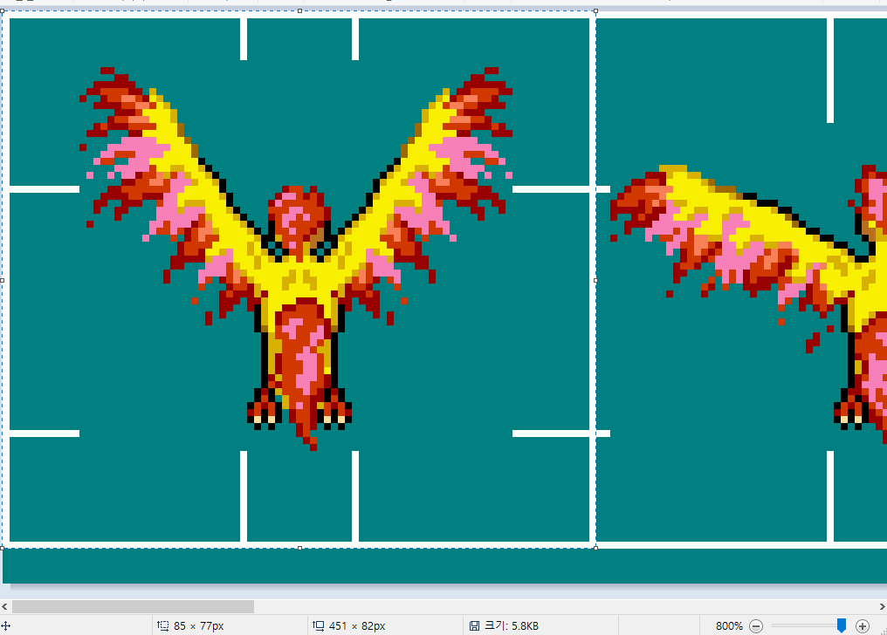
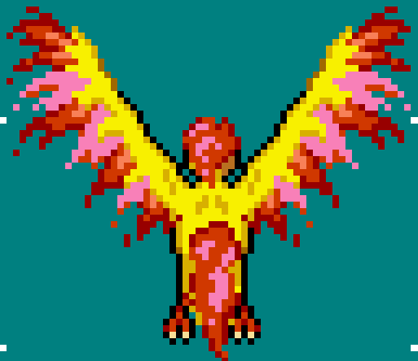
rectImage
{ 0, 0, 85, 77 }
{ 85-1, 0, (85-1)+85, 77 }
HDC
r
bodyDrawPoint
[ rectDraw ]
bodySize
drawSize
rectBody
(from bodySize)

Slide 2
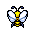
UP
LU
RU
45
45
45
0
180
LEFT
45
45
RIGHT
0
-180

